Slide 1



UOG Journal Club: October 2016
Surgical treatment for hydrosalpinx prior to in-vitro fertilization embryo transfer: a network meta-analysis
A Tsiami, A Chaimani, D Mavridis, M Siskou, E Assimakopoulos, A Sotiriadis
Volume 48, Issue 4, Date: October 2016 (pages 434–445)
Journal Club slides prepared by Dr Shireen Meher
(UOG Editor for Trainees)

Slide 2

Surgical treatment of hydrosalpinx
Tsiami et al., UOG 2016
Introduction
Tubal disease is responsible for 25–30% of all female factor infertility, and the prevalence of hydrosalpinx is 30% in women with tubal pathology.
Women with hydrosalpinx have a poorer outcome after in-vitro fertilization embryo transfer (IVF-ET).
Surgical methods to either aspirate the fluid or remove or isolate the affected fallopian tubes prior to IVF treatment have been attempted as a means of improving outcome.
More invasive procedures such as salpingectomy are non-reversible and could theoretically lead to impaired ovarian function. Tubal occlusion can separate the fluid from the uterus while still retaining the tube. Aspiration is less invasive but recurrence of hydrosalpinx may occur.
Notes:
2

Slide 3
Surgical treatment of hydrosalpinx
Tsiami et al., UOG 2016
Aim of the study
To use network meta-analysis to compare the effectiveness of ultrasound-guided aspiration of hydrosalpinx fluid, salpingectomy, proximal tubal occlusion or no intervention in the management of patients with hydrosalpinx before IVF-ET.
Notes:
3

Slide 4
Surgical treatment of hydrosalpinx
Tsiami et al., UOG 2016
Methods
Study design: network meta-analysis
Inclusion criteria
  Type of studies: randomized controlled trials
  Type of participants: women <40 years with hydrosalpinx visible on ultrasound, who were due to undergo IVF.
  Type of interventions: comparison of ultrasound-guided hydrosalpinx fluid aspiration, salpingectomy or proximal tubal occlusion with each other or no intervention, prior to IVF-ET.
  Type of outcomes:
  Primary outcome: live birth; ongoing pregnancy was used as a surrogate
  when live birth was not reported
  Secondary outcomes: clinical pregnancy (detection of intrauterine gestational sac on US), miscarriage, ectopic pregnancy

Slide 5
Surgical treatment of hydrosalpinx
Tsiami et al., UOG 2016
Methods
Statistical analysis
  Standard random-effects meta-analysis for direct comparisons
  Random effects network meta-analysis synthesizing direct and indirect data from included trials using Network package in Stata.
  Results presented as RR with 95% Confidence Intervals.
  Prediction Intervals (PrIs) estimated to give information on extent and impact of common heterogeneity on treatment effects.
  Relative ranking of the interventions assessed using cumulative ranking curves and calculating surface under the curve (SUCRA).
  Inconsistency plot to assess consistency of treatment effect
  Contribution plots to assess influence of every direct comparison to each network estimate and to the entire network
  Comparison adjusted funnel plots to assess for small study effect
  Analysis by intention to treat

Slide 6

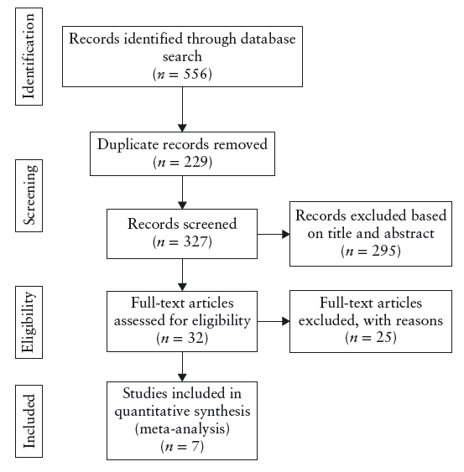
Surgical treatment of hydrosalpinx
Tsiami et al., UOG 2016
Notes:
6

Slide 7
Surgical treatment of hydrosalpinx
Tsiami et al., UOG 2016
Results: description of studies
7 included studies
Interventions:
Salpingectomy most commonly tested (n=306), followed by no intervention (n=258), aspiration (n=167) and tubal occlusion (n=128)
Outcomes
No studies reported on live birth rate, all reported on ongoing pregnancy
Transitivity
Not possible to assess transitivity due to insufficient data, however no obvious discrepancy in study characteristics, interventions or outcomes
Risk of bias
Low

Slide 8
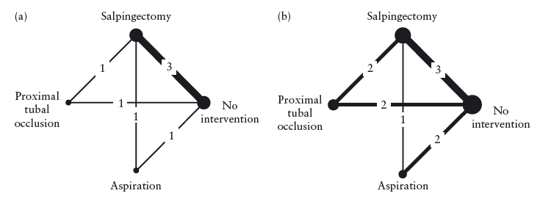
Surgical treatment of hydrosalpinx
Tsiami et al., UOG 2016
Results: Geometry of network meta-analysis

Slide 9
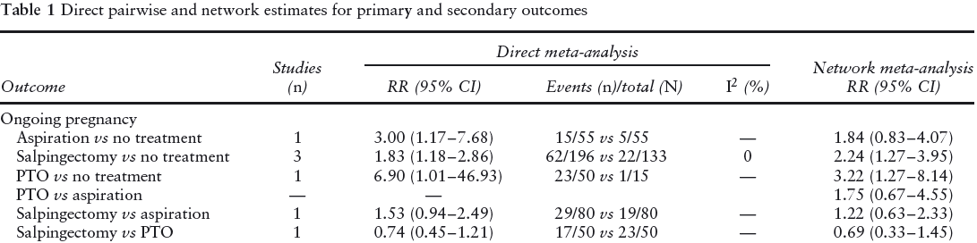
Surgical treatment of hydrosalpinx
Tsiami et al., UOG 2016
Result: primary outcome - ongoing pregnancy
Proximal tubal occlusion and salpingectomy were superior to no intervention.
It was unclear whether aspiration was better than no treatment.
Comparison between the three interventions did not reach statistical significance.
Proximal tubal occlusion had the highest SUCRA value (90%), followed by salpingectomy (63%) and aspiration (44%).

Slide 10
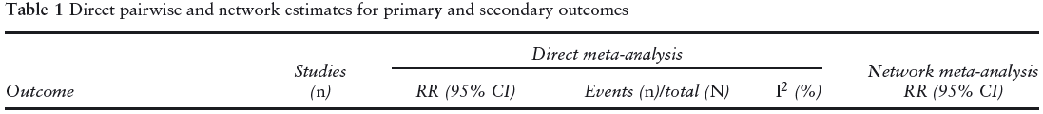
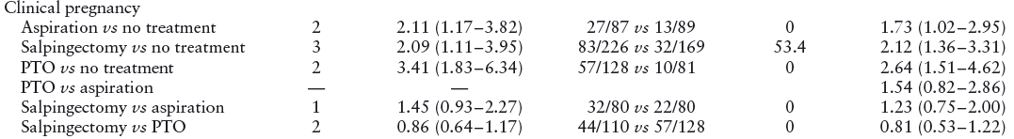
Surgical treatment of hydrosalpinx
Tsiami et al., UOG 2016
Results: secondary outcome - clinical pregnancy
All three interventions appeared to be superior to no intervention
No superiority could be ascertained between the three surgical methods.
Proximal tubal occlusion had the highest SUCRA value (92%), followed by salpingectomy (65%) and aspiration (42%).
Notes:
10

Slide 11
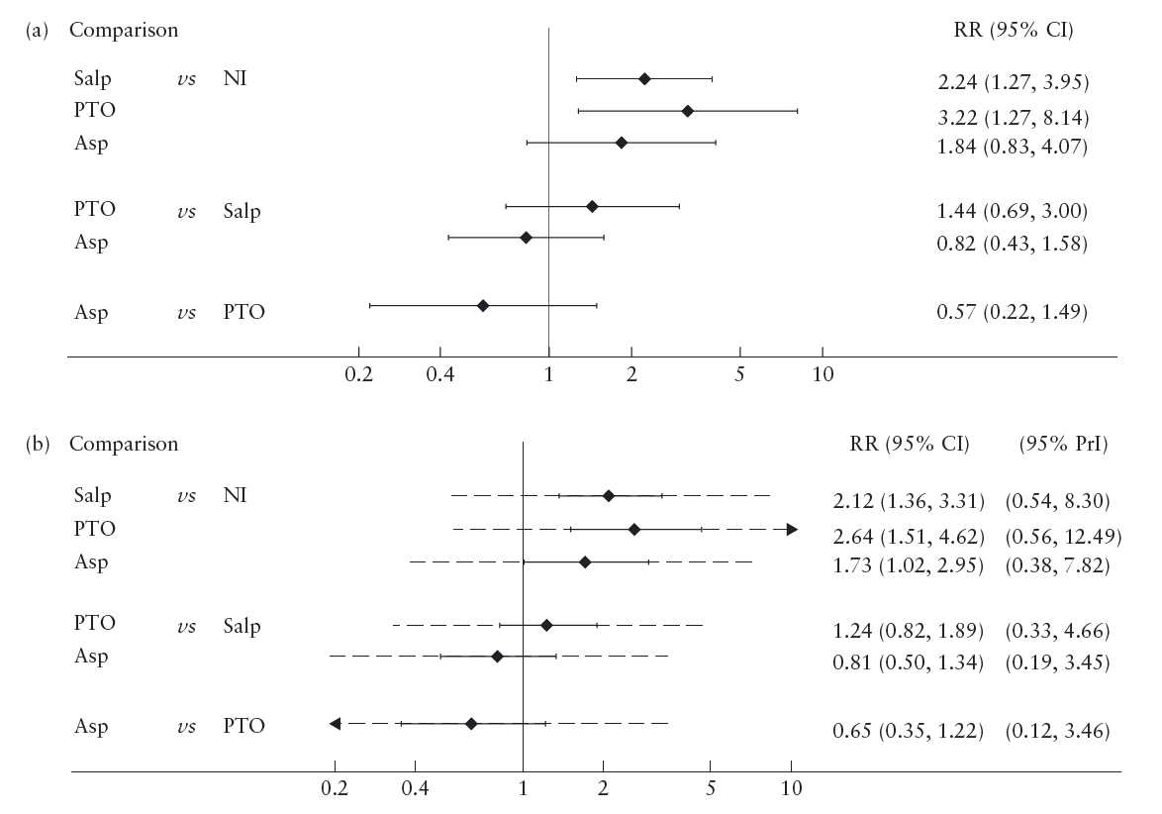
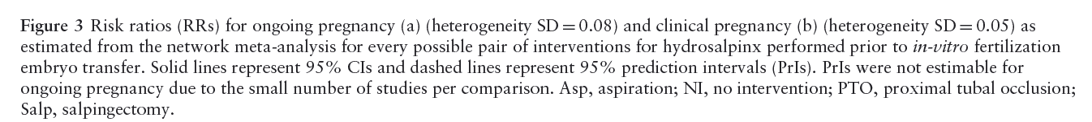
Surgical treatment of hydrosalpinx
Tsiami et al., UOG 2016
Results
Ongoing pregnancy
Clinical pregnancy

Slide 12
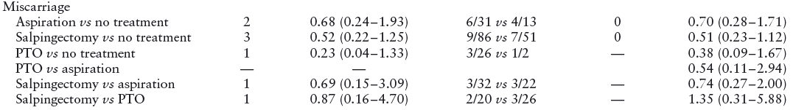
Surgical treatment of hydrosalpinx
Tsiami et al., UOG 2016
Results: secondary outcomes - miscarriage
There were no significant differences between the interventions.
Proximal tubal occlusion had the highest SUCRA value (77%), followed by
salpingectomy (68%) and aspiration (43%).

Slide 13
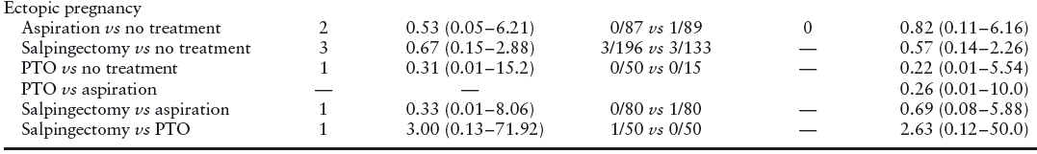
Surgical treatment of hydrosalpinx
Tsiami et al., UOG 2016
Results: secondary outcome - ectopic pregnancy
There were no significant differences between the interventions.
Proximal tubal occlusion had the highest SUCRA value (77%), followed by
salpingectomy (56%) and aspiration (40%).

Slide 14
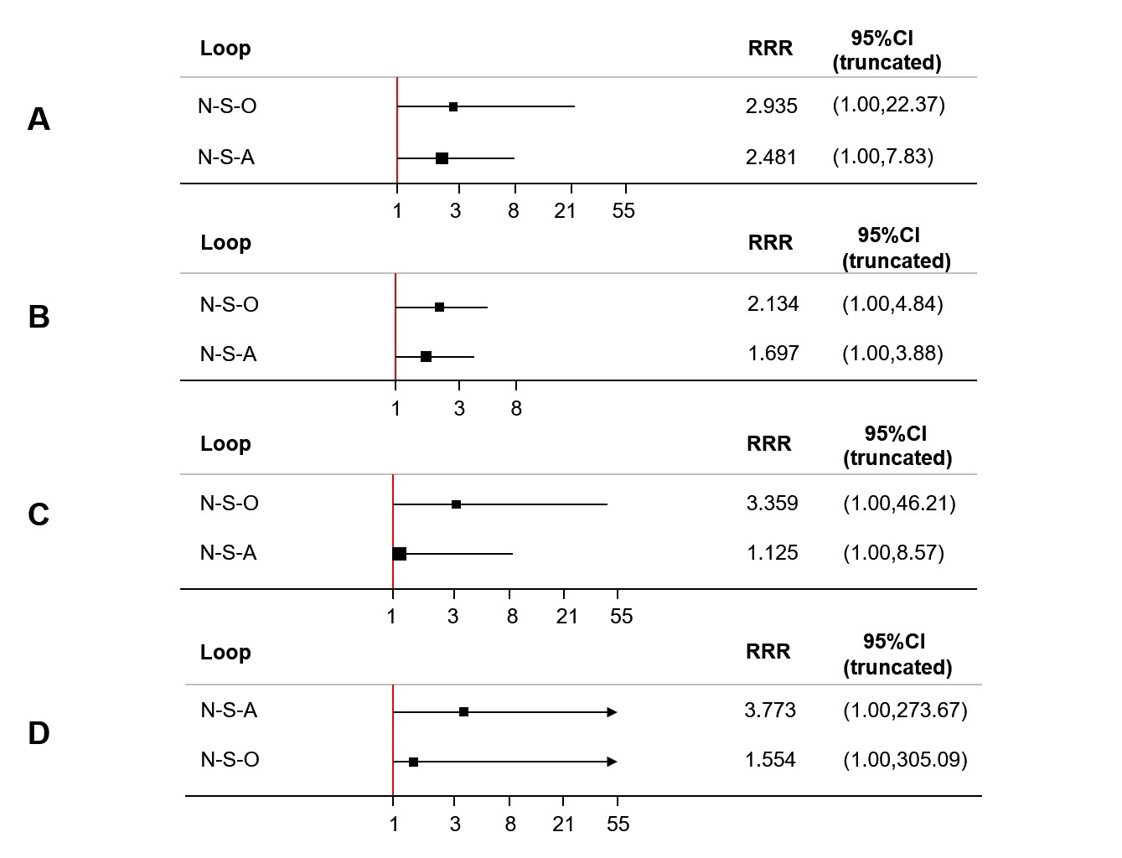
Surgical treatment of hydrosalpinx
Tsiami et al., UOG 2016
Inconsistency Analysis
No significant inconsistency for any of the outcomes (95% CI of RRR included 1)
Large mean RRR for loop of no intervention-occlusion-salpingectomy for all outcomes, indicating that estimates of direct and indirect comparisons may be substantially different.
Large mean RRR for loop of aspiration-no intervention – salpingectomy for ongoing pregnancy, (estimates of direct and indirect comparisons may be substantially different).

Slide 15
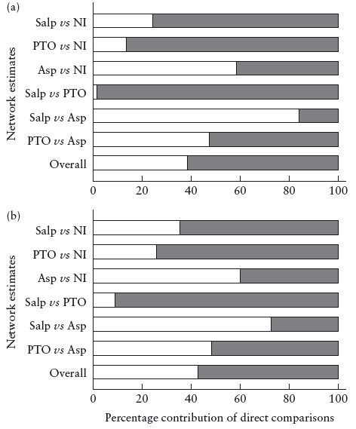
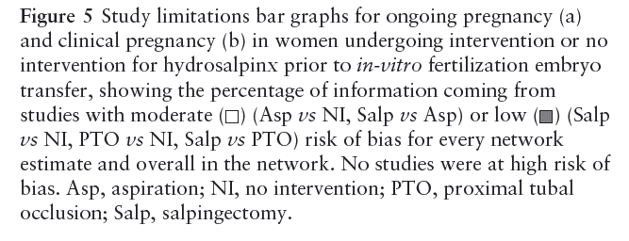
Surgical treatment of hydrosalpinx
Tsiami et al., UOG 2016
Results: quality of evidence

Slide 16
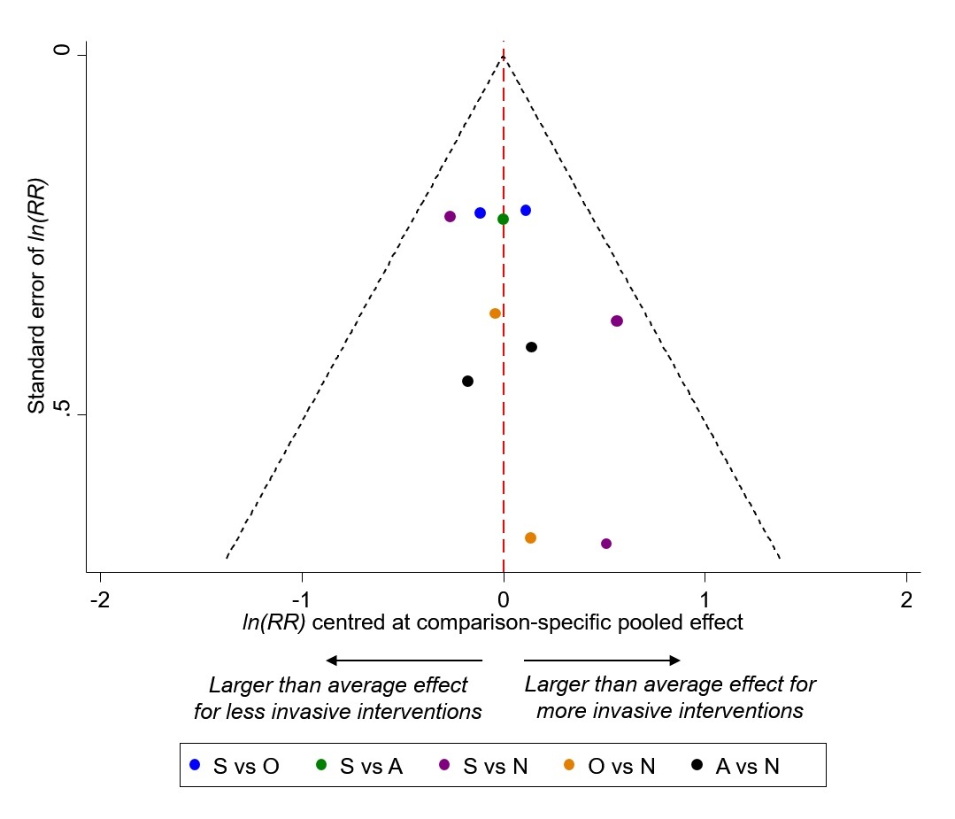
Surgical treatment of hydrosalpinx
Tsiami et al., UOG 2016
Comparison adjusted funnel plot: clinical pregnancy
Funnel plot could only be created
for the outcome of clinical
pregnancy due to insufficient data
Funnel plot shows asymmetry
Small studies tended to favour
more invasive interventions

Slide 17
Surgical treatment of hydrosalpinx
Tsiami et al., UOG 2016
Discussion
This network meta-analysis that compared four strategies for managing hydrosalpinx prior to IVF-ET
  Proximal tubal occlusion and salpingectomy were superior to no intervention for the primary outcome of ongoing pregnancy.
  All three interventions were superior to no intervention for the outcome of clinical pregnancy.
  There were no differences for the outcomes of miscarriage and ectopic pregnancy.
  No significant differences were found between the three treatments in the network comparisons.
  ‘No intervention’ consistently scored as the least effective strategy.
For probabilistic analysis by relative ranking, the two best options for the outcomes of ongoing pregnancy and clinical pregnancy were proximal tubal occlusion and salpingectomy.

Slide 18
Surgical treatment of hydrosalpinx
Tsiami et al., UOG 2016
Discussion
Findings should be interpreted with caution because
  Data were limited.
  Quality of evidence according to GRADE was moderate to low for comparison of intervention vs. no intervention, and low to very low for comparison of two interventions.
  There is a high degree of uncertainty about what works better, particularly with regards to aspiration where the quality of evidence was lowest.
  Confidence intervals are wide, and new studies may show a different direction of effect.
  For the comparisons involving no treatment, the PrIs include 0, which suggests that there could be study settings where the active intervention is not beneficial compared to no treatment. This could be a true finding or due to an overestimation of heterogeneity.
Notes:
18

Slide 19
Surgical treatment of hydrosalpinx
Tsiami et al., UOG 2016
Discussion: comparison with other studies
A Cochrane review (Johnson et al 2010) similarly showed
  Increase in ongoing and clinical pregnancy rates with salpingectomy vs. no intervention (OR 2.14 (95% CI,1.23–3.73) and OR 2.31 (95% CI,1.48–3.62) respectively).
  Increase in clinical pregnancy rates with occlusion vs. no intervention (OR 4.66 (95% CI,2.47–10.01).
A more recent meta-analysis (Zhang et al 2015) did not detect a difference in clinical pregnancy rates between salpingectomy and tubal occlusion.

Slide 20
Surgical treatment of hydrosalpinx
Tsiami et al., UOG 2016
Strengths
Most up to date and complete data set in this area.
Uses both direct and indirect evidence, so improves accuracy.
Allows ranking of interventions where multiple options available.
Limitations
Small sample size, particularly for miscarriage and ectopic pregnancy.
Many comparisons based on indirect evidence only.
Wide confidence intervals for RR and PrIs, suggesting uncertainty of evidence.
Unable to assess transitivity and distribution of effect modifiers across comparisons due to insufficient data.

Slide 21
Surgical treatment of hydrosalpinx
Tsiami et al., UOG 2016
Conclusions
Proximal tubal occlusion and salpingectomy prior to IVF-ET improve ongoing pregnancy rates, compared with no intervention.
Proximal tubal occlusion, salpingectomy and aspiration prior to IVF-ET also improve clinical pregnancy rates compared with no intervention.
Proximal tubal occlusion ranks highest for most outcomes assessed, whereas ‘no intervention’ is consistently the least effective strategy for all outcomes.
Results should be interpreted with caution and not taken as conclusive as the Prls are wide for all comparisons and level of evidence was commonly of low/very low quality.

Slide 22
Surgical treatment of hydrosalpinx
Tsiami et al., UOG 2016
Future perspectives
There is a need for a large RCT comparing proximal tubal occlusion with salpingectomy and aspiration.
Discussion points
How should findings from this study influence clinical practice?
How should findings from this study be used for counseling of patients?
Notes:
22

