Slide 1



UOG Journal Club: May 2016
Prevention of pre-eclampsia by low-molecular-weight
heparin in addition to aspirin: a meta-analysis
S. Roberge, S. Demers, K.H. Nicolaides, M. Bureau, S. Côté and E. Bujold
Volume 47, Issue 5; Date: May, pages: 548–553
Journal Club slides prepared by Dr Maddalena Morlando
(UOG Editor for Trainees)

Slide 2
Prevention of pre-eclampsia by low-molecular-weight
heparin in addition to aspirin: a meta-analysis
Roberge et al., UOG 2016
Pre-eclampsia (PE) is associated with evidence of impaired placentation, and placental vascular lesions are also found in some pregnancies complicated by the delivery of small-for-gestational-age (SGA) neonates.
Meta-analyses of randomized controlled trials (RCTs) have reported that, in pregnancies at high risk of PE, the prophylactic use of low-dose aspirin started ≤16 weeks’ gestation can reduce the prevalence of PE and SGA.
The role of heparin in prevention of these conditions is becoming increasingly apparent, mainly due to its antithrombotic and anti-inflammatory effects, similar to those of aspirin.
The effect of the prophylactic use of aspirin plus low-molecular-weight heparin (LMWH) in high-risk pregnancies on the prevalence of PE and SGA has not been clarified yet.

Slide 3
Prevention of pre-eclampsia by low-molecular-weight
heparin in addition to aspirin: a meta-analysis
Roberge et al., UOG 2016
Objective
To determine if the combined treatment of LMWH and low-dose aspirin starting ≤ 16 weeks’ gestation is superior to the administration of low-dose aspirin alone in the prevention of PE and SGA in women at risk

Slide 4
Prevention of pre-eclampsia by low-molecular-weight
heparin in addition to aspirin: a meta-analysis
Roberge et al., UOG 2016
Methods – literature search
Literature review, according to PRISMA, from 1945 to March 2015.
Systematic search of randomized controlled trials (RCTs) that compared the administration of a combination of any type of LMWH or unfractionated heparin and aspirin with the administration of aspirin alone, started ≤ 16 weeks’ gestation in women at risk of hypertensive disorders.
Search terms included: ‘heparin’, ‘bemiparin’, ‘certoparin’, ‘dalteparin’, ‘enoxaparin’, ‘nadroparin’, ‘parnaparin’, ‘reviparin’, ‘tinzaparin’, ‘LMWH’, ‘aspirin’, ‘acetylsalicylic acid’, ‘preeclampsia’, ‘pre-eclampsia’, ‘PE’, ‘toxaemia’, ‘toxemia’ and ‘eclampsia’.
No language restriction was applied.

Slide 5
Prevention of pre-eclampsia by low-molecular-weight
heparin in addition to aspirin: a meta-analysis
Roberge et al., UOG 2016
Methods – study selection
The quality of studies was evaluated using the Cochrane Handbook Criteria tool for judging risk of bias, and studies with high risk of bias were considered for sensitivity analysis.
The outcome measures were PE, early-onset PE and SGA.
The definition of PE was: systolic blood pressure (BP) ≥ 140mmHg or diastolic BP ≥ 90mmHg occurring > 20 weeks’ gestation in a woman with previously normal BP plus proteinuria, defined as urinary excretion of ≥ 0.3g protein in a 24-h urine specimen or 2+ protein on dipstick. Similar definitions were accepted.
Early-onset PE was defined as PE ≤ 34 weeks of gestation. The definition of SGA was a neonatal birth weight below the 10th, 5th or 3rd percentile (the first available in this order), or an equivalent.

Slide 6
Prevention of pre-eclampsia by low-molecular-weight
heparin in addition to aspirin: a meta-analysis
Roberge et al., UOG 2016
Study selection
Potentially appropriate trials from electronic
search (n = 1807)
Excluded (n = 1557):
• Personal communication, overlapping publication
• Not randomized study with aspirin
• Allocation concealment inadequate
• Relevant outcome not provided
Potentially appropriate trials to be included in meta-analysis (n = 250)
Excluded (n = 209):
• Personal communication, overlapping publication, letter, commentary, editorial, meta-analysis, review
• Other study design
• Inappropriate treatment
• Therapy
• Other reason
Studies meeting inclusion criteria (n = 41)
Excluded (n = 32):
• Not a RCT (n=8)
• Treatment incorrect (n=14)
• Overlapping publication (n=5)
• Incomplete outcome (n=5)
RCTs included in final analysis (n = 8*)
*One study reported in two publications.

Slide 7
Prevention of pre-eclampsia by low-molecular-weight
heparin in addition to aspirin: a meta-analysis
Roberge et al., UOG 2016
Methods – statistical analysis
Pooled relative risks (RRs) were computed for dichotomous outcomes, using Review Manager 5.2.3 software.
Global RRs were calculated according to the random-effects or fixed-effects models, as appropriate.
Heterogeneity between studies was analyzed using the Higgins I² statistic.
The distribution of trials was examined using funnel plots to assess publication bias.
Sensitivity analyses was planned to investigate robustness of the findings and to assess heterogeneity between studies.

Slide 8
Prevention of pre-eclampsia by low-molecular-weight
heparin in addition to aspirin: a meta-analysis
Roberge et al., UOG 2016
Results - 8 studies included
Reference | n | GA at recruitment | Inclusion criteria
Farquharson | 98 | <12 weeks | ≥2 cons. misc. and TP, positive for LAC and/or ACA-Ab
Ferrier | 16 | 10–12 weeks | History of severe PE, renal disease or chronic hypertension
de Vries | 139 | <12 weeks | History of early-onset PE and TP
Goel | 72 | <10 weeks | History of ≥2 misc. and ACA-Ab
Gris | 224 | <12 weeks | History of severe PE
Laskin | 88 | First trimester | History of ≥2 cons. misc. and TP
Malinowski | 109 | Day 16 of menstrual cyle | History of ≥3 cons. misc. and TP
Visser | 139 | <7 weeks | History of ≥2 cons. misc. without TP
GA, gestational age at recruitment; cons., consecutive; misc., miscarriage; LAC, lupus anticoagulant;
ACA-Ab: anticardiolipin antibodies; TP, thrombophilia.

Slide 9
Prevention of pre-eclampsia by low-molecular-weight
heparin in addition to aspirin: a meta-analysis
Roberge et al., UOG 2016
Results - 8 studies included: interventions
Reference | Heparin | Aspirin (mg) | Outcome
Farquharson | Unspecified LMWH, 5000 IU | 75 | PD
Ferrier | Dalteparin, 5000 IU | 100 | PE, severe PE, early/late PE, PD
de Vries | Dalteparin, 2500–7500 IU | 75–100 | PE, SGA, early/late PE
Goel | Unfractionated heparin, 5000 IU | 80 | PE, early/late PE, PD
Gris | Enoxaparin, 4000 IU | 100* | PE, severe PE, SGA, PD
Laskin | Dalteparin, 5000 IU | 81 | SGA, PD
Malinowski | Unspecified LMWH, 20 mg | 75 | SGA
Visser | Enoxaparin, 40 mg | 100 | PE, SGA
*Taken at bedtime. LMWH, low-molecular-weight heparin; PD, perinatal death.

Slide 10
Prevention of pre-eclampsia by low-molecular-weight
heparin in addition to aspirin: a meta-analysis
Roberge et al., UOG 2016
Results
Results were stratified according to the entry criteria due to the wide heterogeneity between inclusion criteria for the two subgroups of women, and a random-effects model was used.
The Higgins I² statistic demonstrated no heterogeneity between studies for PE and early-onset PE (I² = 0%) and low heterogeneity for SGA (I² = 22%).
The small number of studies precluded sensitivity analyses and the evaluation of publication biases.
The majority of included studies were judged to have low or unclear risk of bias, except for the blinding to the treatment allocation (no placebo in all RCTs).

Slide 11
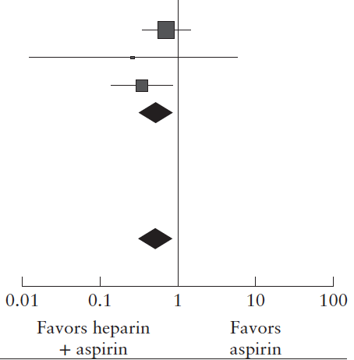
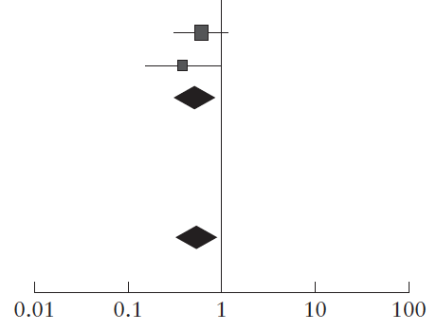
Prevention of pre-eclampsia by low-molecular-weight
heparin in addition to aspirin: a meta-analysis
Roberge et al., UOG 2016
Results
In women with a history of PE, the addition of LMWH to low-dose aspirin reduced the risk of PE and SGA
Risk ratio M-H, random, 95%CI
Risk ratio M-H, random, 95%CI
Risk of PE: three trials (n=379)
RR, 0.54 (95% CI, 0.31–0.92); P = 0.03
Risk of SGA: two trials (n=363)
RR, 0.54 (95% CI, 0.32–0.91); P = 0.02

Slide 12
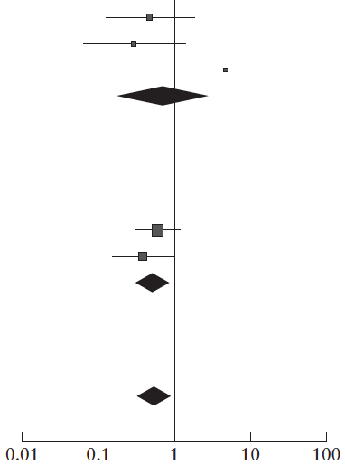
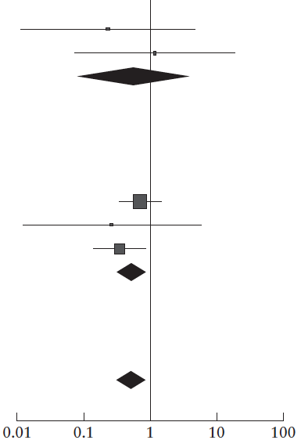
Prevention of pre-eclampsia by low-molecular-weight
heparin in addition to aspirin: a meta-analysis
Roberge et al., UOG 2016
Results
In women with recurrent miscarriage, the risks for PE and SGA were not significantly reduced by addition of LMWH to low-dose aspirin
Risk ratio M-H, random, 95%CI
Risk ratio M-H, random, 95%CI
Risk of PE: two trials (n=211)
RR, 0.57 (95% CI, 0.08–4.35); P = 0.59
Risk of SGA: three trials (n=337)
RR, 0.73 (95% CI, 0.18–2.99); P = 0.66

Slide 13
Prevention of pre-eclampsia by low-molecular-weight
heparin in addition to aspirin: a meta-analysis
Roberge et al., UOG 2016
Results
In women with a history of PE, LMWH with low-dose aspirin:
Appears to show a trend in the reduction of early-onset PE:
  Two trials (n=155)
  RR, 0.14 (95% CI, 0.02–1.10); P=0.06
But not late-onset PE:
  Two trials (n=155)
  RR, 1.20 (95% CI, 0.53–2.72); P=0.65

Slide 14
Prevention of pre-eclampsia by low-molecular-weight
heparin in addition to aspirin: a meta-analysis
Roberge et al., UOG 2016
Conclusions
Based on limited evidence, the combination of LMWH and low-dose aspirin started in early pregnancy could reduce the prevalence of PE and SGA in women with a history of PE.
This observation should be the basis of a well-conducted future trial rather than a recommendation for immediate clinical application.
In women with recurrent miscarriage, there appeared to be no benefit of adding LMWH, compared to low-dose aspirin alone.
In high-risk pregnancies, the prophylactic use of LMWH is beneficial in reducing adverse pregnancy outcome only when there is concomitant therapy with low-dose aspirin.

Slide 15
Prevention of pre-eclampsia by low-molecular-weight
heparin in addition to aspirin: a meta-analysis
Roberge et al., UOG 2016
Strengths
This is the first meta-analysis evaluating the effect of the combined treatment with aspirin plus LMWH starting ≤16 weeks’ gestation in high-risk pregnancies on the prevalence of PE and SGA.
Limitations
The main limitation is the small number of studies/patients fulfilling the inclusion criteria - precluding sensitivity analyses and the evaluation of publication biases. Other limitations include heterogeneity in inclusion criteria, dose of aspirin and outcome measures. Half (4/8) of the studies included women with thrombophilia. Finally, the cost benefits or side effects of LMWH were not assessed.

Slide 16
Prevention of pre-eclampsia by low-molecular-weight
heparin in addition to aspirin: a meta-analysis
Roberge et al., UOG 2016
Discussion Points
Most women who develop preterm PE (85%) have not had previous PE. How should we identify the high-risk women in the first trimester of pregnancy who will benefit from the administration of LMWH?
Will LMWH with aspirin work in high risk groups identified by other means such as 1st trimester uterine Doppler and PlGF?
Does the study show that the use of LMWH with aspirin will have an impact on perinatal mortality and long-term outcomes?
What are the cost benefits or side effects of LMWH?

