Slide 1



UOG Journal Club: January 2016
Clinical implementation of routine screening for fetal trisomies in the UK NHS: cell-free DNA test contingent on results from first-trimester combined test
MM Gil, R Revello, LC Poon, R Akolekar, KH Nicolaides
Volume 47, Issue 1, Date: January 2016 (pages 42–52)
Journal Club slides prepared by Dr Shireen Meher
(UOG Editor for Trainees)

Slide 2
Clinical implementation of cfDNA testing
MM Gil et al., UOG 2016
Introduction
Screening for trisomy 21 in UK NHS hospitals is currently based on the first-trimester combined test, which has a potential prenatal detection rate of about 90% for trisomy 21 and 95% for trisomies 18 or 13, at a false-positive rate (FPR) of 5%.
Cell-free DNA (cfDNA) analysis of maternal blood for detection of trisomies 21, 18 and 13 is superior to other methods of screening, with detection rates of 99%, 96% and 91% respectively, at a FPR of 0.35%.
cfDNA analysis may be used as a first-line method of screening or contingent on the results of the first-trimester combined test.
As cfDNA is currently an expensive test, one strategy to maximize screening performance at reduced cost is to offer cfDNA testing as contingent screening.
Notes:
2

Slide 3
Clinical implementation of cfDNA testing
MM Gil et al., UOG 2016
Aim of the study
To report the feasibility of implementing cfDNA screening contingent on the results of the first-trimester combined test.
To examine factors affecting patient decisions concerning their options for screening and decisions on the management of affected pregnancies.
To report the prenatal diagnosis of fetal trisomies and outcome of affected pregnancies following contingent screening.
Notes:
3

Slide 4
Clinical implementation of cfDNA testing
MM Gil et al., UOG 2016
Methods
Study design: prospective study between October 2013 and February 2015
Setting: two hospitals in England
Inclusion criteria:
  women with singleton pregnancy between 11 and 13 weeks’ gestation
  attending hospital for routine care
Exclusions:
  pregnancies ending in termination, miscarriage or stillbirth with no known karyotype
  pregnancies lost to follow-up
Intervention: routine clinical implementation of contingent screening
  All women were offered combined screening, and on the basis of their result, divided into
    High-risk group (risk ≥1 in 100): offered invasive testing, or cfDNA testing or no further testing
    Intermediate-risk group (risk between 1 in 101 and 1 in 2500): offered cfDNA testing or no further testing
    Low-risk group (risk <1 in 2500): reassured, no further testing offered

Slide 5
Clinical implementation of cfDNA testing
MM Gil et al., UOG 2016
Methods
Outcomes:
  Trisomic status of the pregnancies as determined by prenatal or postnatal karyotyping or by examination of the neonates, and outcome of these pregnancies following screening.
  Factors affecting parental decision making in choosing options for testing and management of pregnancies.
Statistical analysis:
  To compare outcome groups, the Mann–Whitney U-test was used for continuous variables and χ2-test/Fisher’s exact test for categorical variables.
  Logistic regression using SPSS for significant predictors of opting for CVS in the high-risk group and cfDNA testing in the intermediate-risk group.
Ethics approval obtained

Slide 6

Clinical implementation of cfDNA testing
MM Gil et al., UOG 2016
Results
12 134 women offered combined screening, 11 921 accepted (98.2%)
229 (1.9%) excluded from analysis due to pregnancy loss with no known karyotype (n=169) or lost to follow-up (n=60)
Mean maternal age in study population: 31 years
Based on results of the combined screening, the 11 692 pregnancies were classified as
  High risk: 460 women (3.9%)
  Intermediate risk: 3552 women (30.4%)
  Low risk: 7680 women (65.7%)
Diagnosis of trisomies in the study population of 11 692 pregnancies was
  Trisomy 21: 47 cases
  Trisomy 18: 24 cases
  Trisomy 13: 4 cases
  No trisomies: 11 617 pregnancies
Notes:
6

Slide 7
Clinical implementation of cfDNA testing
MM Gil et al., UOG 2016
Results: potential performance of combined screening
The combined test result was ≥ 1 in 100 (high risk) in
  87% (41/47) of fetuses with trisomy 21
  92% (22/24) of fetuses with trisomy 18
  100% (4/4) of fetuses with trisomy 13
  3.4% (393/11 617) of non-trisomic pregnancies
Five cases of trisomy 21 and two of trisomy 18 were in the intermediate-risk group
One case of trisomy 21 was in the low-risk group
The combined test followed by invasive testing for all high-risk women could potentially have detected 87% of trisomy 21 and 93% of trisomies 18 or 13, at a FPR of 3.4%.
However, in the high-risk group, only 38% of women chose invasive testing.

Slide 8
Clinical implementation of cfDNA testing
MM Gil et al., UOG 2016
Results: potential performance of cfDNA testing
The cfDNA test was carried out in 3698 pregnancies from high- and intermediate-risk groups.
The test provided a result for 97.3% after first sampling and 98.2% after second sampling
65 pregnancies had no results from cfDNA testing
  5/65 had results from invasive testing (couples chose to have both CVS and cfDNA testing)
  60/65 had no further tests – all cases had normal outcomes
The median time interval for results was 8 (range, 4–21) days, with 98.7% being available within 14 days.
The cfDNA test was screen positive for
  98% (43/44) of tested fetuses with trisomy 21 (1 false negative)
  88% (21/24) of tested fetuses with trisomy 18 (no test result in 3 cases)
  50% (2/4) of tested fetuses with trisomy 13 (2 false negatives)
  0.25% (9/3564) of non-trisomic pregnancies (FPR)

Slide 9
Clinical implementation of cfDNA testing
MM Gil et al., UOG 2016
Results: performance of contingent screening
Contingent screening led to the prenatal detection of
  92% (43/47) of fetuses with trisomy 21
  100% (28/28) of fetuses with trisomies 18 or 13
Contingent screening did not detect four cases of trisomy 21
  1 case in low-risk group – no further tests offered
  2 cases in high/intermediate-risk groups but parents declined further testing
  1 false-negative result

Slide 10
Clinical implementation of cfDNA testing
MM Gil et al., UOG 2016
Summary of screening performance
Karyotype | No. of fetuses | Screen positive by combined screening | Screen positive by cfDNA screening | Screen positive by contingent screening
Trisomy 21 | 47 | 87% (41/47) | 98% (43/44) | 92% (43/47)
Trisomy 18 | 24 | 92% (22/24) | 88% (21/24) | 100% (24/24)
Trisomy 13 | 4 | 100% (4/4) | 50% (2/4) | 100% (4/4)
No trisomy | 11 617 | 3.4% (393/11 617) | 0.25% (9/3564)
Notes:
10

Slide 11
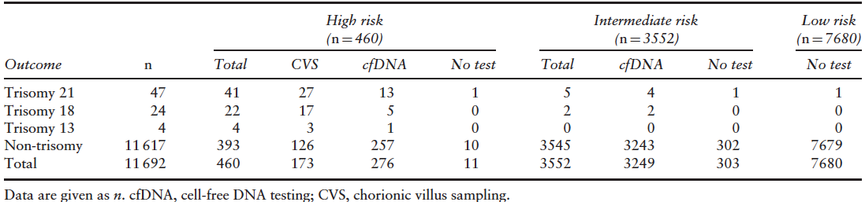
Clinical implementation of cfDNA testing
MM Gil et al., UOG 2016
Results: parental decision regarding further investigations
In the high-risk group, 38% opted for CVS, 60% for cfDNA and 2% for no further investigation
  In the intermediate-risk group 92% opted for cfDNA and 9% for no further investigation

Slide 12
Clinical implementation of cfDNA testing
MM Gil et al., UOG 2016
Results: parental decisions in high-risk group
With implementation of contingent screening in the high-risk group (n=460)
  38% opted for CVS
  60% opted for cfDNA testing
  2% did not want further tests
Without contingent screening in the previous year, among the high-risk group (n=407)
  66% had opted for invasive testing
  34% had no further investigations
Contingent screening was associated with a 43% reduction in invasive testing

Slide 13
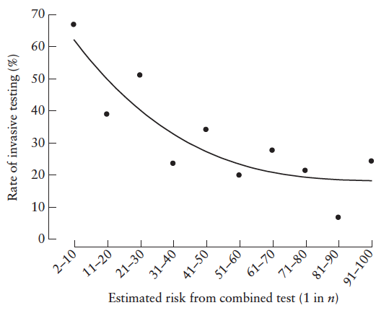
Clinical implementation of cfDNA testing
MM Gil et al., UOG 2016
Results: parental decision in high-risk group
Significant independent predictors for opting for CVS
  Increasing risk for trisomies
  Increasing fetal nuchal translucency measurement
Significant independent predictors for opting against CVS
  Afro-Caribbean racial origin
  Attending hospital in which results from combined screening were not given on the same visit as the scan

Slide 14
Clinical implementation of cfDNA testing
MM Gil et al., UOG 2016
Results: parental decisions in high-risk group
41 cases of trisomy 21 in high-risk group
  27 chose CVS
  13 chose cfDNA test
  1 chose no further investigations
13 cases with a positive cfDNA result
  9 parents had confirmatory CVS
  4 parents did not want further testing
Rate of pregnancy termination in trisomy 21
  93% (25/27) in those choosing invasive testing
  36% (5/14) in those choosing cfDNA testing or no tests

Slide 15
Clinical implementation of cfDNA testing
MM Gil et al., UOG 2016
Results: parental decision in intermediate-risk group
Significant independent predictors for opting for cfDNA testing
  Increasing risk for trisomies
  Increasing maternal age
Significant independent predictors for opting against cfDNA testing
  Afro-Caribbean racial origin
  Smoking
  Being parous
  Attending hospital in which results from combined screening were not given at the same visit as the scan
5 cases of trisomy 21 in intermediate-risk group
  4 parents chose cfDNA testing
  1 chose no further investigations
3 cases of trisomy 21 with a positive cfDNA result
  2 had termination of pregnancy
  1 continued pregnancy

Slide 16
Clinical implementation of cfDNA testing
MM Gil et al., UOG 2016
Results: pregnancy outcome in trisomies
Among 43 prenatally detected cases of trisomy 21
  74% (32/43) opted for pregnancy termination
  26% (11/43) chose to continue with pregnancy
32% (15/47) of trisomy 21 fetuses were live born
Among 28 prenatally detected cases of trisomy 18 or 13
  82% (23/28) opted for termination of pregnancy
  18% (5/28) chose to continue with pregnancy (resulting in 3 miscarriages or fetal deaths and 2 neonatal deaths)

Slide 17
Clinical implementation of cfDNA testing
MM Gil et al., UOG 2016
Discussion
This study demonstrates the feasibility of introducing contingent cfDNA testing for major trisomies in routine clinical practice.
In the high-risk group, 38% opted for invasive testing, 60% for cfDNA testing and 2% for no further tests. In the intermediate-risk group, 91.5% opted for cfDNA testing and 8.5% for no further tests.
Introduction of cfDNA testing reduced uptake of invasive testing by an estimated 43%.
In the high-risk group, uptake of cfDNA testing was partly at the expense of invasive testing but mainly as a new option in women who would have previously chosen to have no further investigations.
Choice between CVS and cfDNA was influenced by a number of factors including
  risk of trisomy
  racial origin: Afro-Caribbean more averse to invasive testing
  parental attitudes about termination of pregnancy: termination was chosen by 93% of trisomy cases in CVS group compared to 36% of those opting for cfDNA or no testing.

Slide 18
Clinical implementation of cfDNA testing
MM Gil et al., UOG 2016
Discussion
Contingent screening could have potentially detected most trisomies with a lower invasive rate.
However the theoretical performance of contingent screening does not equate to rate of prenatal diagnosis and termination because
  many high-risk women chose invasive testing
  some declined confirmatory testing
  many chose to continue the pregnancy with an affected fetus
Based on these findings, health economics analyses may not be entirely valid as they assume that
  cfDNA will replace the more expensive invasive testing, and cost savings could be utilized to offer cfDNA testing to the intermediate-risk group
  improved prenatal detection of trisomies would result in lower rates of affected live births, therefore cost savings from postnatal care

Slide 19
Clinical implementation of cfDNA testing
MM Gil et al., UOG 2016
Limitations of the study
The study was not designed for comparison of screening performance between the combined and cfDNA tests as the number of trisomic pregnancies was too small for valid conclusion.
Rates of uptake of specific screening options may not be generalizable to all populations from different racial and socioeconomic backgrounds in different countries and healthcare systems.

Slide 20
Clinical implementation of cfDNA testing
MM Gil et al., UOG 2016
Discussion: comparison with other studies
Study | Type of study | No. of pregnancies | Affected cases | Traditional screening | cfDNA test
Nicolaides 2012 | Compared combined screening with cfDNA test on stored plasma samples - cfDNA result not used clinically | 1949 singleton 11–13 weeks | 10 trisomies | 100% detection FPR 4.5% | 100% detection FPR 0.1%
Bianchi 2014 | Compared 1st/2nd trimester screening with cfDNA test -cfDNA result not used clinically | 1914 17 (range, 8–39) weeks | 8 trisomies | 100% detection FPR 4.2% | 100% detection FPR 0.5%
Norton 2015 | Compared combined screening with cfDNA test on stored plasma samples - cfDNA result not used clinically | 15 841 10–14 weeks | 38 trisomy 21 | 79% detection FPR 5.4% | 100% detection FPR 0.06%
Song 2012 | Compared cfDNA test with second-trimester triple serum screening test, cfDNA implementation study | 1741 16 (range, 11–21) weeks | 11 trisomies | 55% detection FPR 14.1% | 100% detection FPR 0.06%
Quezada 2015 | Compared cfDNA testing with combined test, cfDNA implementation study | 2785 cfDNA: 10–11 weeks combined test: 11–13 weeks | 32 trisomy 21 10 trisomy 18 5 trisomy 13 | 100% detection FPR 4.4% | 100% detection for T21, 90% for T18, 40% for T13 FPR 0.3%

Slide 21
Clinical implementation of cfDNA testing
MM Gil et al., UOG 2016
Conclusion
In healthcare systems offering routine screening for trisomy 21 by the first-trimester combined test, incorporating the option of cfDNA testing for some patients is feasible.
Such contingent screening could potentially lead to the prenatal detection of a higher proportion of affected pregnancies and a lower invasive-testing rate than in screening by the combined test alone.
In clinical practice, prenatal detection of trisomies and pregnancy outcome depend not only on performance of screening tests but also on parental choice.
Clinical implementation of cfDNA testing, contingent on results of the combined test, may have only a modest impact in reducing the rate of invasive testing and a small effect on the rate of live births with trisomy 21.

Slide 22
Clinical implementation of cfDNA testing
MM Gil et al., UOG 2016
Future perspectives
Further studies are needed on economic analyses of contingent screening, taking into account impact of parental choice on uptake of invasive testing and termination rates.
Discussion points
Should cfDNA testing for trisomies be introduced into routine clinical practice as contingent screening or first-line screening?
Notes:
22

