Slide 1



UOG Journal Club: June 2016
Single deepest vertical pocket or amniotic fluid index as evaluation test for predicting adverse pregnancy outcome (SAFE trial): a multicenter, open-label, randomized controlled trial
S Kehl, A Schelkle, A Thomas, A Puhl, K Meqdad, B Tuschy, S Berlit, C Weiss,
C Bayer, J Heimrich, U Dammer, E Raabe, M Winkler, F Faschingbauer, MW Beckmann, M Sutterlin
Volume 47, Issue 6, Date: June (pages 674–679)
Journal Club slides prepared by Dr Shireen Meher
(UOG Editor for Trainees)

Slide 2
SDP or AFI as evaluation test
S Kehl et al., UOG 2016
Introduction
Amniotic fluid volume is an integral part of assessment of fetal wellbeing.
Estimation of amniotic fluid volume is carried out by measuring either amniotic fluid index (AFI) or single deepest vertical pocket (SDP).
No consensus on the best method to assess amniotic fluid volume.
RCTs in high-risk, post-term and intrapartum women show that both techniques are poor predictors of adverse pregnancy outcome.
There is less knowledge on the usefulness of these techniques in low-risk and term pregnancies.
Notes:
2

Slide 3
SDP or AFI as evaluation test
S Kehl et al., UOG 2016
Aim of the study
To determine, in both high-risk but and low-risk pregnancies, which technique for estimating amniotic fluid volume (AFI or SDP) is the best test to predict adverse pregnancy outcome.
Notes:
3

Slide 4
SDP or AFI as evaluation test
S Kehl et al., UOG 2016
Methods
Study design
  Multicenter, open-label RCT
Setting
  Four hospitals in Germany (July 2012 to September 2013)
Participants
  Included: women with a singleton pregnancy at term and cephalic presentation, presenting for delivery or pre-labor examination.
  Excluded: women with primary Cesarean section, premature rupture of the membranes, no ultrasound examination in the last 7 days, structural/chromosomal fetal malformation, intrauterine fetal death, placenta previa or any contraindication to vaginal delivery.

Slide 5
SDP or AFI as evaluation test
S Kehl et al., UOG 2016
Methods
Intervention
  Women randomised to AFI or SDP measurement for estimation of amniotic fluid volume
  The diagnosis of oligohydramnios (AFI ≤5.0 cm or absence of SDP measuring at least 2 × 1 cm) was followed by labor induction
Primary outcome
  Postpartum admission to neonatal intensive care unit (NICU)
Other outcomes:
  Rate of perinatal death, oligohydramnios, induction of labor (for oligohydramnios or without specific indication), umbilical artery pH <7.10, 5-min Apgar score <7, meconium-stained amniotic fluid, abnormal cardiotocography, need for fetal scalp blood sampling, assisted vaginal delivery and Cesarean section.

Slide 6
SDP or AFI as evaluation test
S Kehl et al., UOG 2016
Methods
Randomization
  Computer-generated 1:1 allocation sequence, consecutively numbered sealed opaque envelopes.
Statistical calculations
  SAS software, with pre-specified statistical tests, P-value < 0.05 for statistical significance, RR with 95% Confidence Intervals.
Sample size
  Reduction in rate of postpartum NICU admission from 5% using AFI method to 2.5% with SDP technique needed a sample size of 804 for both groups (assuming α = 0.05, power = 0.80 and equal group sizes). Allowing for attrition, planned enrollment was 500 in each arm.

Slide 7

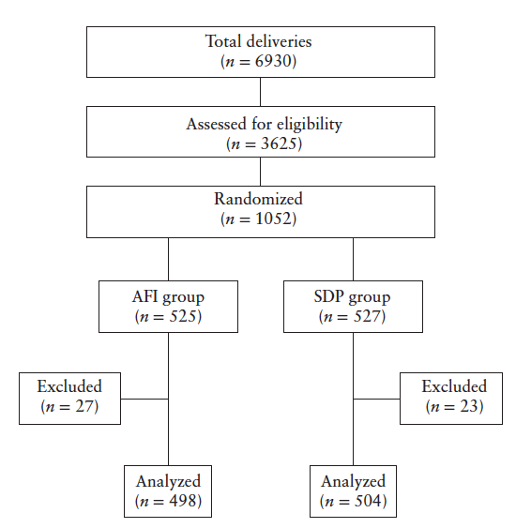
SDP or AFI as evaluation test
S Kehl et al., UOG 2016
Results: flowchart
No amniotic fluid measurement <7 days before delivery = 16
Deviation from study protocol = 5
Delivered in different hospital = 6
No amniotic fluid measurement = 16
Deviation from study protocol = 6
Delivered in different hospital = 1
Notes:
7

Slide 8
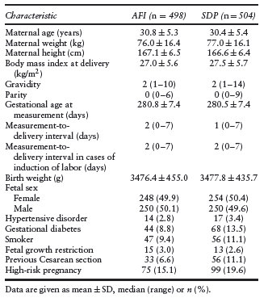
SDP or AFI as evaluation test
S Kehl et al., UOG 2016
Results
Baseline characteristics
In the AFI group, fewer women had
gestational diabetes
a previous Cesarean section

Slide 9
SDP or AFI as evaluation test
S Kehl et al., UOG 2016
Results
Primary outcome: postpartum admission to NICU
  No significant difference between AFI and SDP groups
  4.2% (n=21) vs 5.0% (n=25); RR, 0.85 (95% CI, 0.48–1.50); P=0.57
Secondary outcomes with statistically significant differences
  Increased risk of diagnosis of oligohydramnios in AFI group
  (9.8% (n=49) vs 2.2% (n=11); RR, 4.51 (95% CI, 2.37–8.57); P<0.01
  Increased risk of labor inductions for oligohydramnios in AFI group
  (12.7% (n=33) vs 3.6% (n=10); RR, 3.50 (95% CI, 1.76–6.96); P<0.01
  Increased risk of abnormal CTG in AFI group
  (32.3% (n=161) vs 26.2% (n=132); RR, 1.23 (95% CI, 1.02–1.50); P=0.03

Slide 10
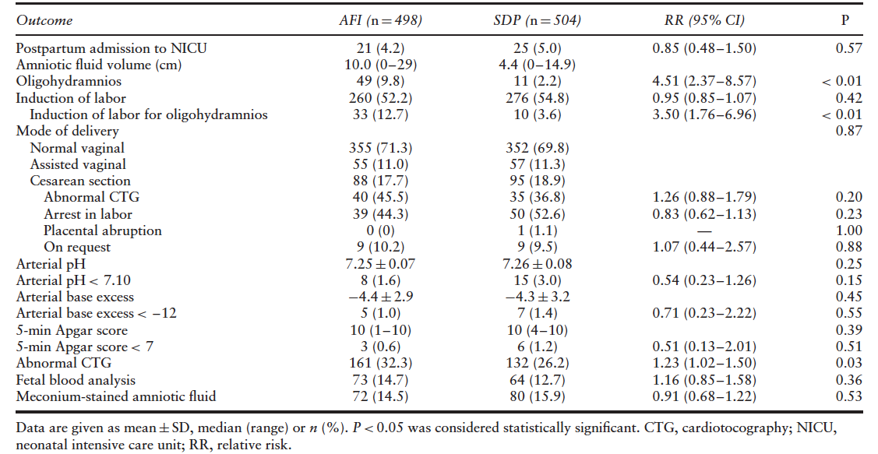
SDP or AFI as evaluation test
S Kehl et al., UOG 2016
Notes:
10

Slide 11
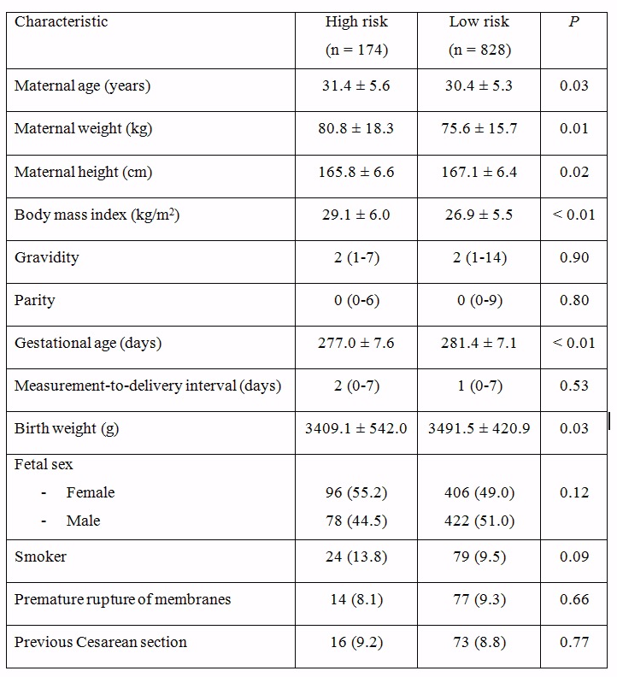
SDP or AFI as evaluation test
S Kehl et al., UOG 2016
Subgroup analysis: characteristics of high-risk vs low-risk women
Low-risk pregnancies: 828
High-risk pregnancies: 174
Compared to women with a low-risk pregnancy, women with a high-risk pregnancy were:
older (P=0.03)
shorter (P=0.02)
more overweight (P<0.01)
at earlier gestations (P<0.01)

Slide 12
SDP or AFI as evaluation test
S Kehl et al., UOG 2016
Results: high-risk vs low-risk pregnancies
In low-risk pregnancies
  Increased diagnosis of oligohydramnios using AFI 9.9% vs 2.0%; RR 5.03 (95% CI, 2.39–10.58))
  More labor inductions for oligohydramnios using AFI 15.3% vs 3.9%; RR, 3.89 (95% CI, 1.84–8.27))
  More cases of arterial pH < 7.10 seen in SDP 3.5% vs 1.2%; RR, 0.34 (95% CI, 0.12–0.94))
In high-risk pregnancies
  None of the above findings were significantly different between the AFI and SDP groups
  The only significant difference between AFI and SDP groups was a lower arterial pH in the AFI group (7.25 ± 0.08 vs 7.28 ± 0.07)

Slide 13
SDP or AFI as evaluation test
S Kehl et al., UOG 2016
Discussion
Neither the AFI nor SDP technique was superior in predicting adverse pregnancy outcome.
Using AFI method resulted in increased diagnoses of oligohydramnios, and subsequent induction of labor for oligohydramnios.
Abnormal CTG was seen more often using AFI compared to SDP technique.
In low-risk pregnancies, the rate of oligohydramnios was higher with AFI compared to SDP measurement, but this was not significantly higher in high-risk pregnancies - possibly due to smaller sample size in the group.
In low-risk pregnancies, an umbilical arterial pH < 7.10 was found more often when SDP technique was used. Since arterial base excess < –12.0 and 5-min Apgar score < 7 were not different between groups, this finding was not considered clinically relevant.
Notes:
13

Slide 14
SDP or AFI as evaluation test
S Kehl et al., UOG 2016
Discussion: comparison with other studies
A Cochrane review similarly showed
  AFI method for fetal surveillance increased the risk for induction of labor (RR, 1.92 (95% CI, 1.50–2.46); 4 trials; 2138 pregnancies)
  there was no difference between the two groups for rate of admission to NICU (RR, 1.04 (95% CI, 0.85–1.26); 5 trials; 3226 babies)
The Cochrane review also found increased risk of Cesarean section for fetal distress when AFI technique is used (RR, 1.46 (95% CI, 1.08–1.96)). This study found increased risk of abnormal CTG but not Cesarean section.
  As there were more women with gestational diabetes and previous Cesarean section in the SDP group, it remains possible that Cesarean-section rate could have been higher in this study in the AFI group if these risk factors were balanced in the two groups.

Slide 15
SDP or AFI as evaluation test
S Kehl et al., UOG 2016
Conclusions
Use of the AFI method in routine obstetric assessment resulted in more women being diagnosed with oligohydramnios and being induced for an abnormal amniotic fluid volume without improving the perinatal outcome.
The SDP method is therefore the favorable method to estimate amniotic fluid volume, especially in a population with low-risk pregnancies.

Slide 16
SDP or AFI as evaluation test
S Kehl et al., UOG 2016
Future perspectives
There is a need to explore alternative methods for amniotic fluid volume assessment that have better correlation with adverse pregnancy outcomes.
Discussion points
Should the use of AFI technique for assessment of amniotic fluid volume be abandoned, for both low- and high-risk pregnancies?
What is the clinical significance of increased rate of abnormal CTG seen with the AFI method in this study and increased Cesarean sections for fetal distress in the Cochrane review? Could AFI be identifying a more vulnerable population of babies?
Notes:
16

